Slide 2
Using your Web Browser,
Open this URL:
Click on the workshop you’re attending, and find:
1
http://mlhlocal.host/lhd-resources
2
Setup Instructions
The Code Samples
A demo project
A Workshop FAQ
These Workshop Slides
More Learning Resources
Notes:
What to Say:
Tell attendees we are going to check them in for the event
Once attendees check in, they will receive an email with the items listed on the slide
Attendees must check-in to get credit for attending this event
What to Do:
Confirm that everyone has checked in by asking participants to give you a signal when they receive the email.

Slide 3

Our Mission is to Empower Hackers.
65,000+
HACKERS
12,000+
PROJECTS CREATED
3,000+
SCHOOLS
We hope you learn something awesome today!
Find more resources: http://mlh.io/
Notes:
What to Say:
Major League Hacking (MLH) events are meant to bring hackers together so they can learn, build, and share.
Give participants a brief overview of Major League Hacking (MLH).
Tell participants they can learn more at http://mlh.io/
Example Talking Points:
Through Localhost MLH is rethinking technology education to reflect how hackers actually learn and how fast the industry moves.
Here’s some quick facts about MLH:
Each year, MLH supports over 65,000 hackers around the world at events they facilitate
Those students create more than 12,000 amazing projects together
MLH is a global organization that empowers hackers at more than 3,000 schools and growing every day

Slide 4
What will you learn today?
1
Understand Voice User Interfaces & what you can build using them.
2
Meet Alexa, an intelligent personal assistant developed by Amazon.
3
Create your first voice powered app with Amazon Alexa.
Notes:
What to Say:
Explain to participants what they will learn today
Learning is a core part of being a hacker and today they are going to learn something new
What to Do:
Get participants excited about the experience.

Slide 5
Table of Contents
1. Introduction to Alexa & Voice UIs
2. Developing For Alexa
3. Develop Your Alexa Skill
4. Customize The Skill
5. Test The Skill
6. Publish Your Skill
7. Review & Quiz
8. Next Steps

Slide 6
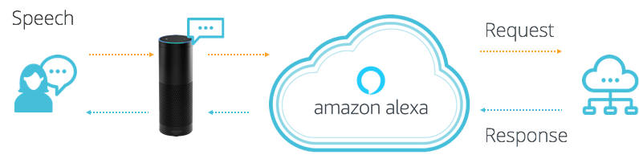
What is Alexa?
Alexa is a Voice User Interface (VUI), that lets you speak commands, instead of clicking buttons or typing on your keyboard.
Alexa listens to spoken input, uses it to execute tasks or skills in the cloud, and then returns output -- just like a JavaScript function.
Notes:
What to Say:
Voice User Interfaces (VUIs) enable you to speak commands rather than typing them on a keyboard or swiping a touchscreen.
Alexa is Amazon's voice service that listens to spoken input, uses it to execute computing tasks, and then returns output
What to Do:
Demonstrate Alexa by asking questions in front of the audience. If you have a physical device, use that. Otherwise, you can use the browser simulator (https://www.echosim.io/)
“Alexa, what is the weather?”
“Alexa, tell me a joke.”

Slide 7


Why do Voice UIs Matter?
Instead of typing, clicking, or tapping - we can physically separate ourselves from our devices and speak commands naturally.
Voice UIs can run code in the cloud and communicate with IoT devices, making them ideal for homes, cars, & more.
Notes:
What to Say:
VUIs signify a big shift in how we interact with technology
We can physically separate ourselves from devices and speak naturally
When our hands are busy, we can interact with our devices and apps without looking up
What to Do:
Ask the audience, “where might voice user interfaces be useful?”. Pick people who raise their hand. Here are some common answers:
While driving the car
When running or exercising
While cooking a meal

Slide 8

What can you build with Alexa?
“Alexa, ask Lyft for a Lyft Line to work.”
Notes:
What to Say:
Alexa is programmable, so you can connect it to webapps and other APIs
You could build smart remotes for your TV, a skill to hail a cab, order a pizza, etc.
The next few slides contain some examples.
Lyft - you can ask Alexa to call a lyft cab to your location.

Slide 9


What can you build with Alexa?
“Alexa, ask Capital One, what did I spend?”
Notes:
What to Say:
Capital One - Check on your bank account and spending habits.

Slide 10
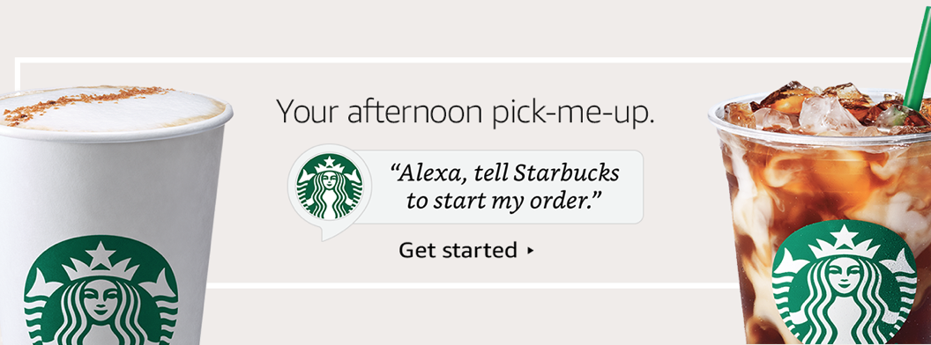
What can you build with Alexa?
“Alexa, tell Starbucks start my order.”
Notes:
What to Say:
Starbucks - order your coffee ahead of time when you’re walking out the door.

Slide 11
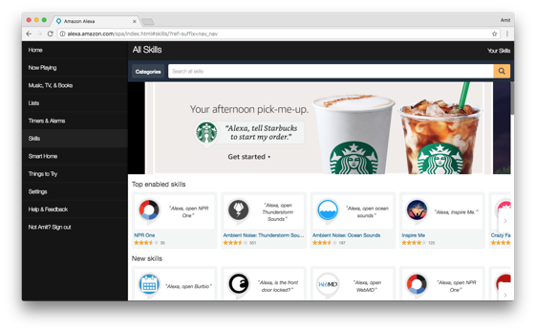
Alexa has Skills. Lots of them.
Companion app for device setup, skills, remote control, and more.
alexa.amazon.com
Notes:
What to Say:
Alexa has tons of skills you can use today
You can also search and discover skills by visiting amazon.com/skills
Today you are going to learn how to make one.
What to Do:
Ask participants if they have used any other Alexa apps or skills. Here are some other popular ones if you need examples:
NPR - Listen to Podcasts
Seamless - Order delivery to your house
Jeopardy - Play Jeopardy with Alexa.

Slide 12
Table of Contents
1. Introduction to Alexa & Voice UIs
2. Developing For Alexa
3. Develop Your Alexa Skill
4. Customize The Skill
5. Test The Skill
6. Publish Your Skill
7. Review & Quiz
8. Next Steps

Slide 13
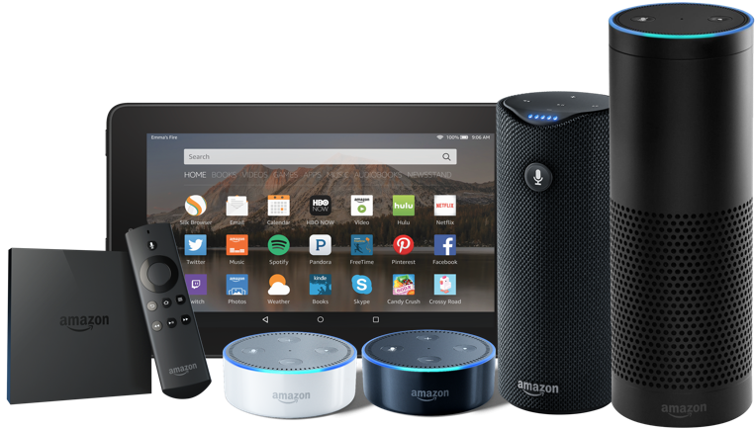
Why build an Alexa Skill?
Alexa, Amazon's voice service, is already integrated into Echo devices and can perform hundreds of skills.
Your skill can reach millions of customers with Alexa enabled devices.
Building with Alexa is free, easy, & fun!
Notes:
What to Say:
Why should you build an Alexa skill?
Alexa is already integrated into many devices include the Echo.
Amazon has millions of customers who could use your Alexa Skill
Building on Alexa is fun, easy, and free.

Slide 14

Alexa Skills are made of 2 parts:
Front End - The Alexa Voice UI handles text to speech, converting the audio into something our app can use, etc.
Back End - The logic code that actually powers our app. Usually this is written using the Alexa Code Editor.
Notes:
What to Say:
Each Alexa skill is made of two parts
Front End is the Alexa Voice User Interface. This takes user speech and converts it into something the computer can understand
Back End is where your application logic lives. This takes the parsed speech and does something interesting with it.
FAQ:
What is AWS Lambda?
You can think of Lambda as an event-driven computing platform; Lambda runs when triggered by an event and executes code that’s been loaded into the system. You don’t need to setup or manage any servers, just write the code and Amazon takes care of the rest.

Slide 15
Table of Contents
1. Introduction to Alexa & Voice UIs
2. Developing For Alexa
3. Develop Your Alexa Skill
4. Customize The Skill
5. Test The Skill
6. Publish Your Skill
7. Review & Quiz
8. Next Steps

Slide 16
Now that you know more about how Alexa works, let's make an Alexa Developer account.

Slide 17
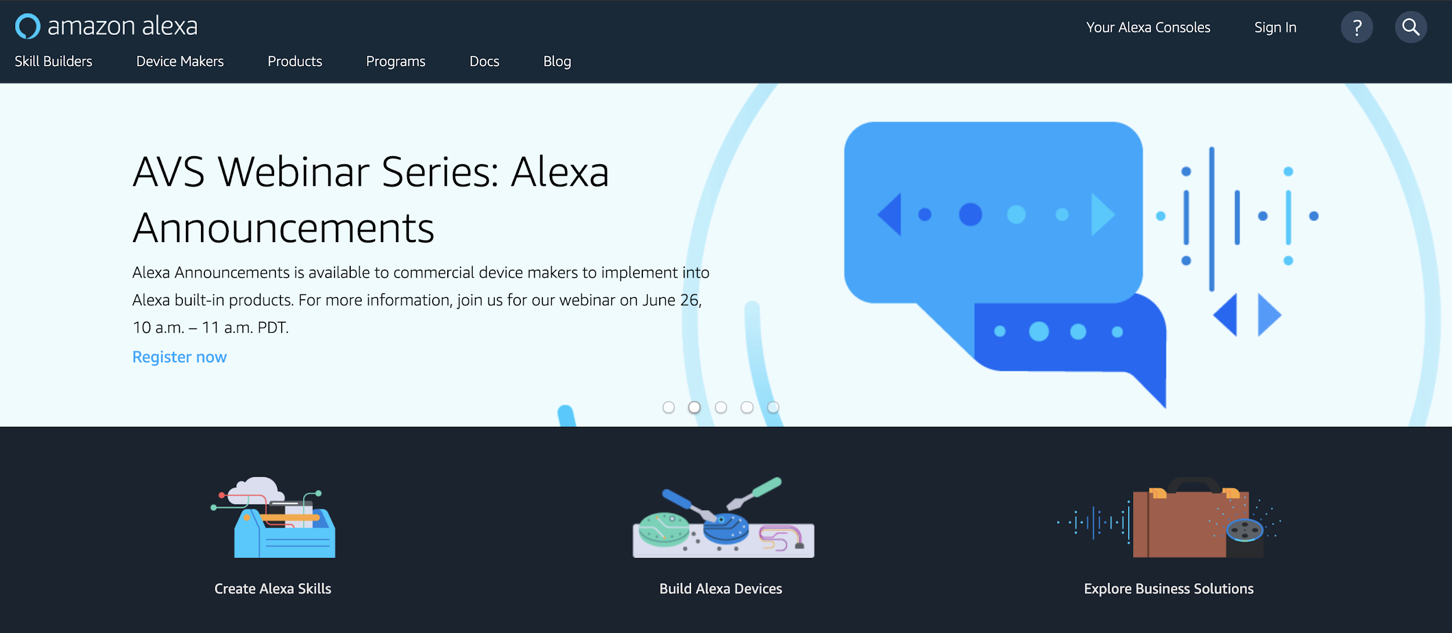
Sign into the Amazon Developer Portal
Navigate to mlhlocal.host/alexa-portal.
Click Sign In.
Notes:
What to Say:
Alexa skills are managed through the Amazon developer portal (developer.amazon.com).
The URL on the screen is a shortcut to the Alexa specific content.
You’ll need to sign in using the Amazon account you used to create your Alexa skill function.
You may also need to register for a developer account.
What to Do:
Make sure everyone is able to sign in to the Amazon developer portal.

Slide 18
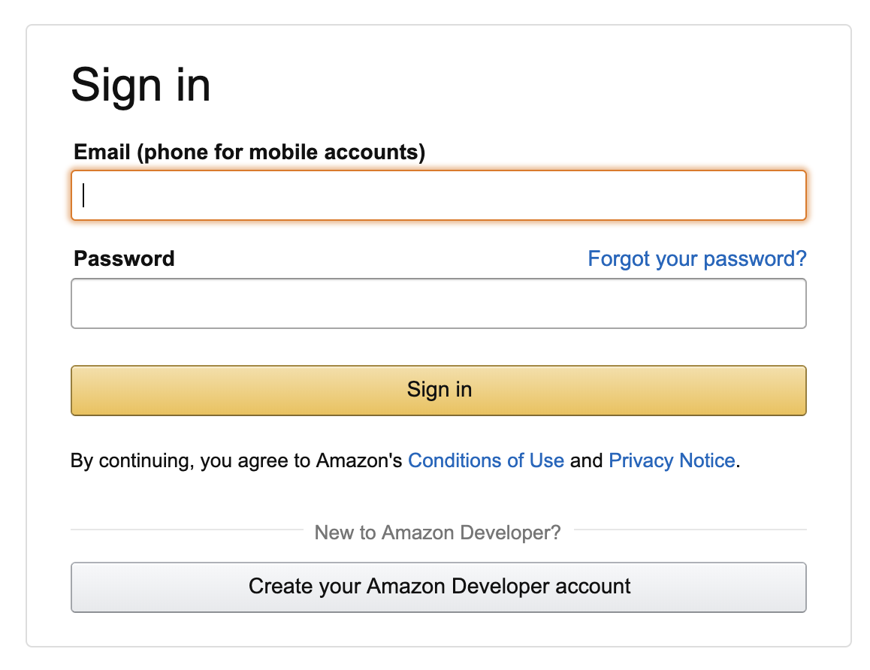
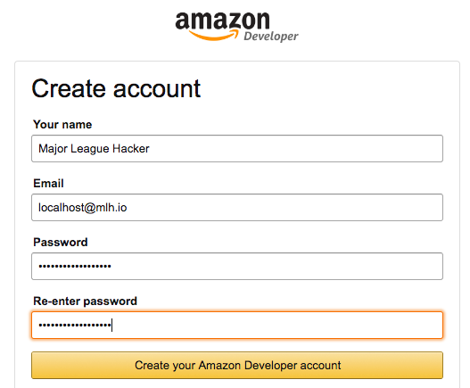
Create your account
If you have an Amazon Developer Account, sign in. If you do not, select Create your Amazon Developer account.
Notes:
What to Say:
Pick a strong password with special characters, numbers, and lower and upper case letters
What to Do:
Make sure everyone is able to sign in to the Amazon developer portal.
The next slide shows the profile creation step, so move on once you see that everyone is there.

Slide 19
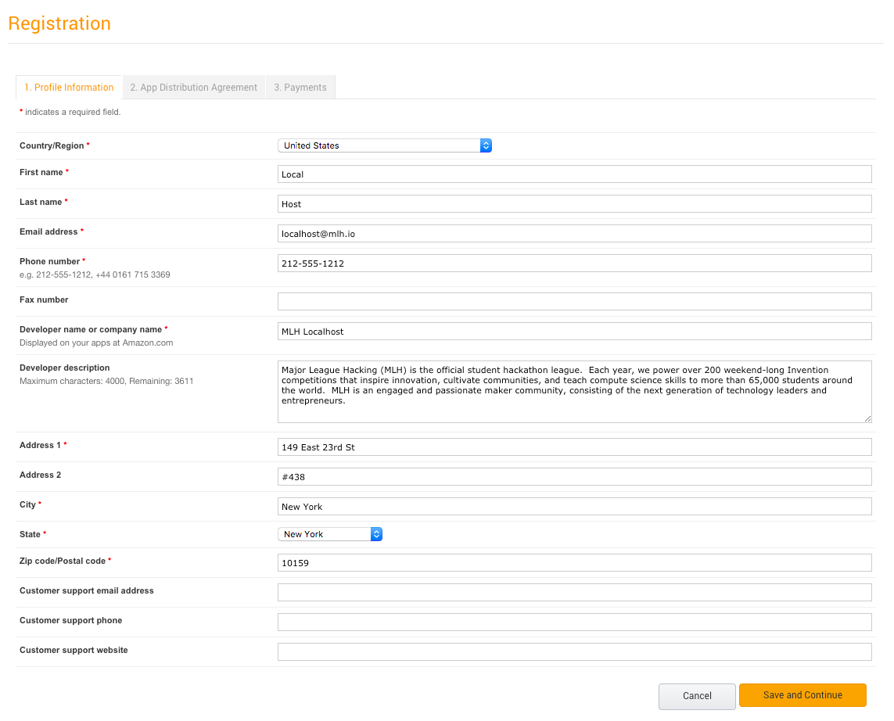
Create your Developer Profile
Fill out the registration form.
Notes:
What to Say:
To register for your developer account fill out this form.
What to Do:
Make sure everyone is able to sign in to the Amazon developer portal.

Slide 20
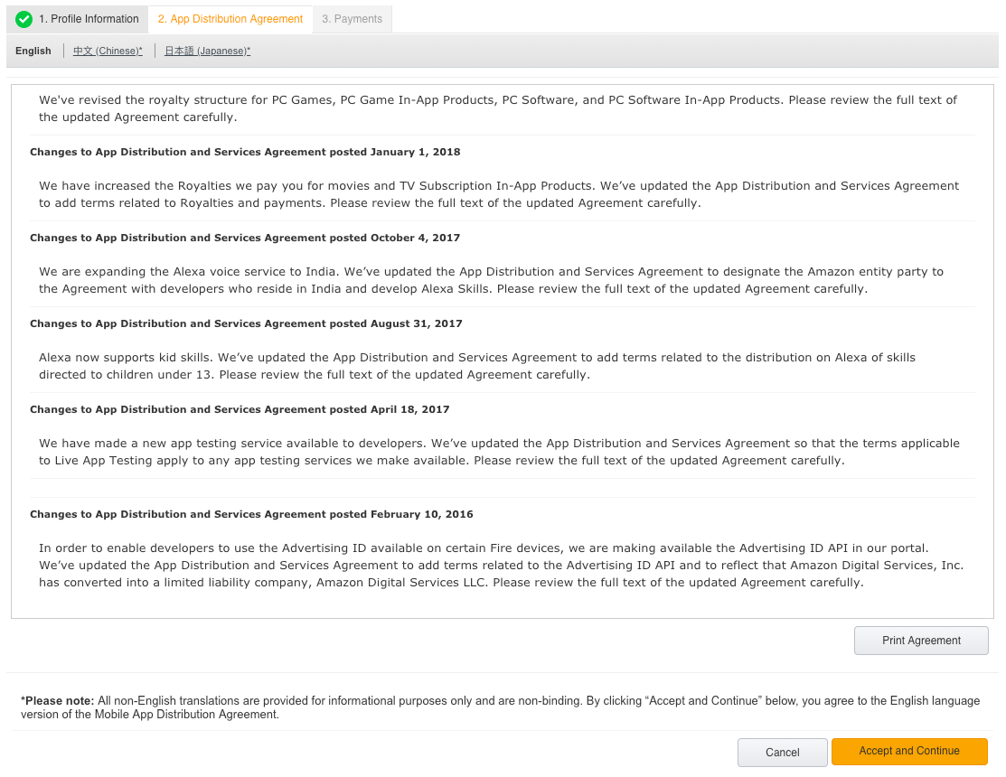
Create your Developer Profile
Agree to the Terms of Use.
Notes:
What to Say:
To register for your developer account agree to the terms of usage.
What to Do:
Make sure everyone is able to sign in to the Amazon developer portal.

Slide 21
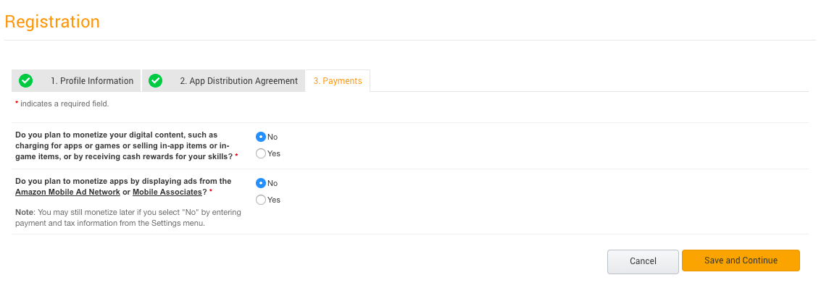
Create your Developer Profile
Select "No" for both options on this screen.
Save and Continue.
Notes:
What to Say:
Since we are not going to be monetizing these apps, click No for both the questions in this page.
What to Do:
Make sure everyone is able to sign in to the Amazon developer portal.

Slide 22
Now that you have an Amazon Developer account, we can test the skill we're going to build!

Slide 23
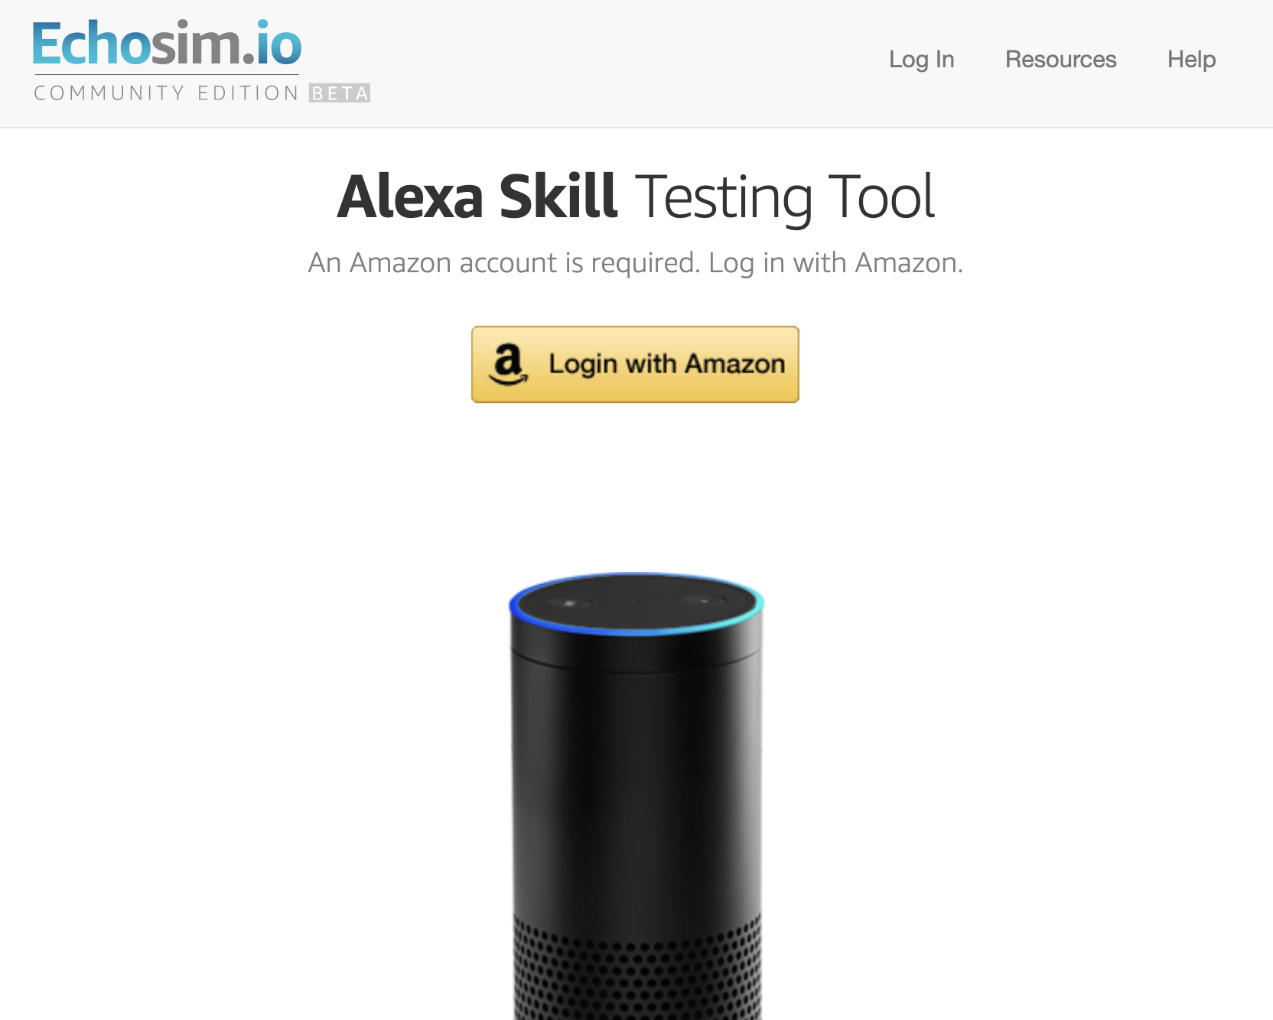
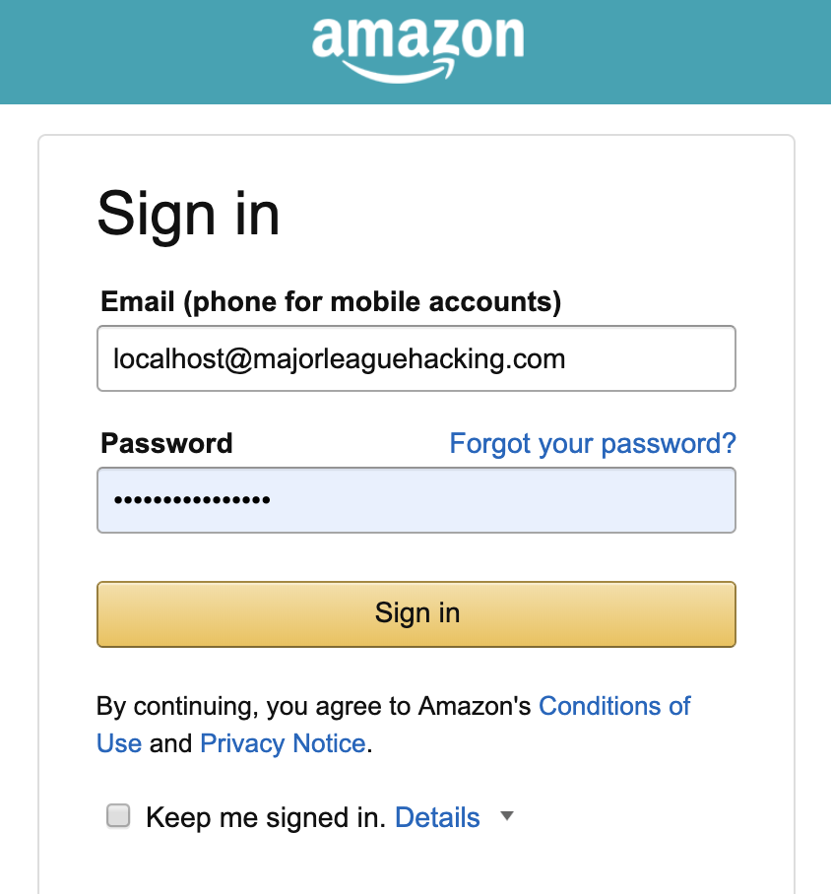
Demo: Cake Walk Skill
In another tab in your browser, navigate to Echosim.io.
Select Login with Amazon.
Enter your information and sign in.
Notes:
Setup:
Make sure you have the Cake Walk skill enabled. You can do this from the Alexa App on your phone.
What to Say:
We’re going to demo a skill that MLH made which asks for your birthday and remembers it!
What to Do:
Demonstrate the Cake Walk Alexa Skill by asking Alexa the following:
“Alexa, open cake walk.”
“Alexa, ask cake walk for my birthday.”
If you have a physical device, use that. Otherwise use the Echo Simulator. (http://echosim.io/)

Slide 24
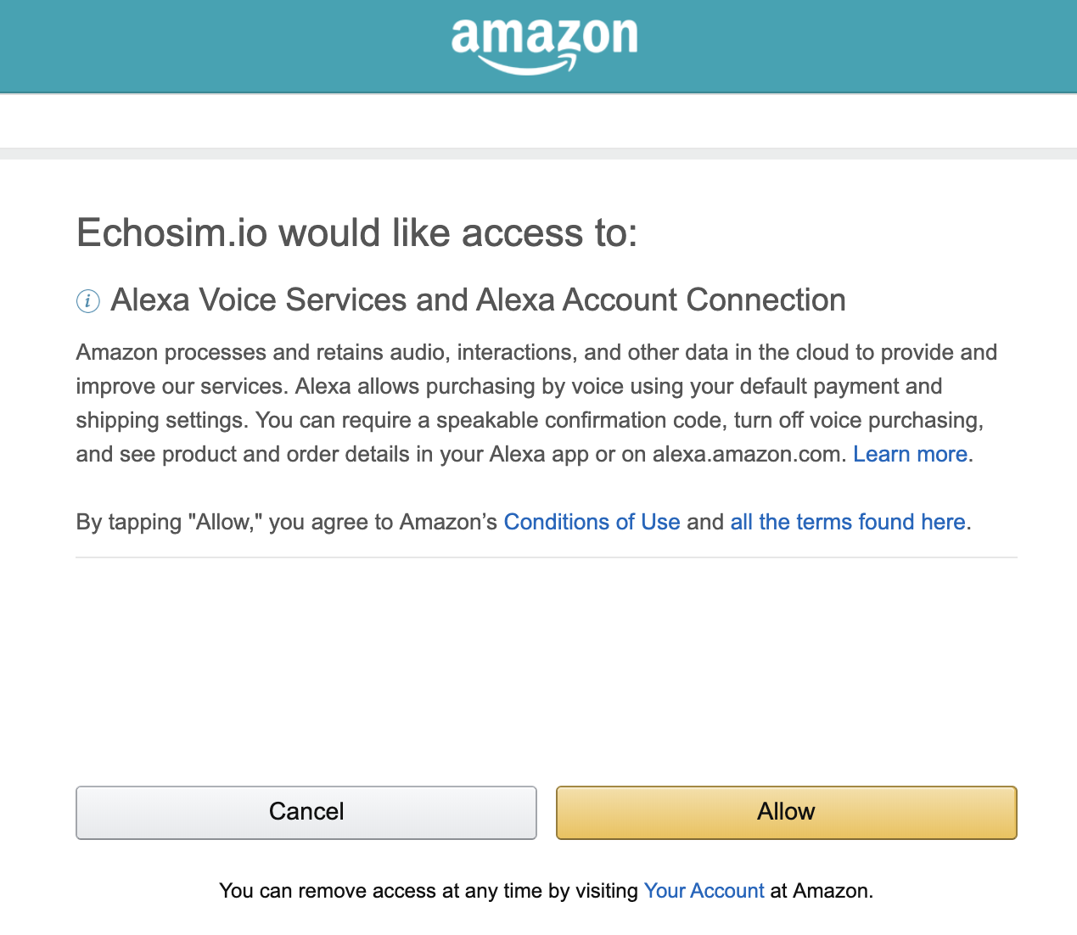
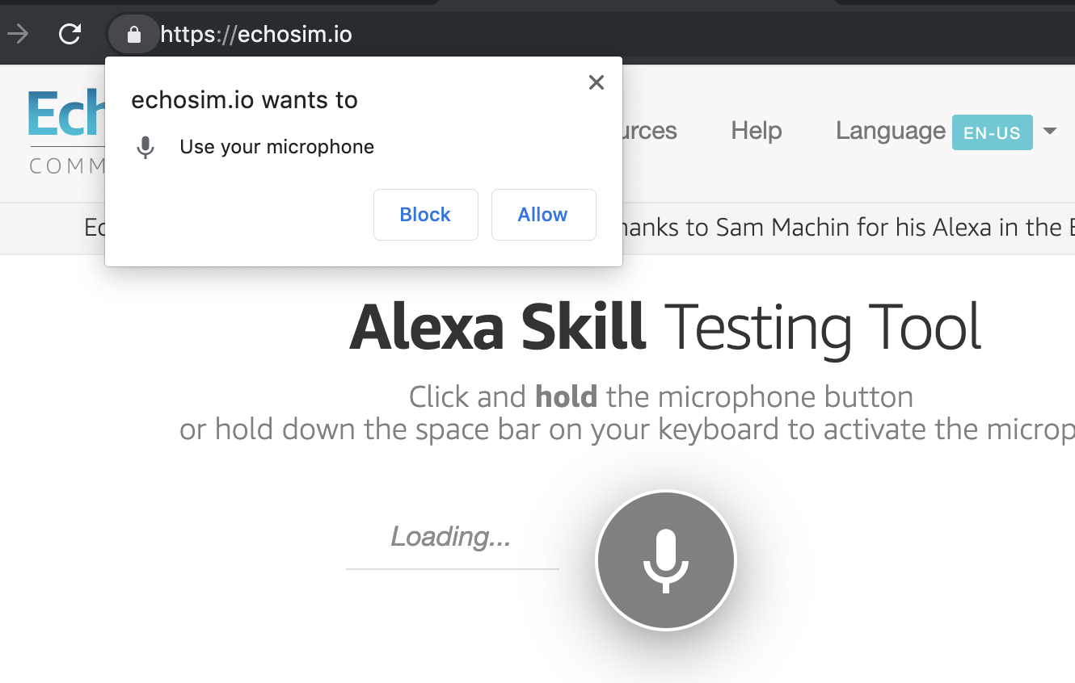
Demo: Cake Walk Skill
Select Allow to connect your account.
If prompted, allow the browser to use your microphone.
Notes:
Setup:
Make sure you have the Cake Walk skill enabled. You can do this from the Alexa App on your phone.
What to Say:
We’re going to demo a skill that MLH made which asks for your birthday and remembers it!
What to Do:
Demonstrate the Cake Walk Alexa Skill by asking Alexa the following:
“Alexa, open cake walk.”
“Alexa, ask cake walk for my birthday.”
If you have a physical device, use that. Otherwise use the Echo Simulator. (http://echosim.io/)

Slide 25
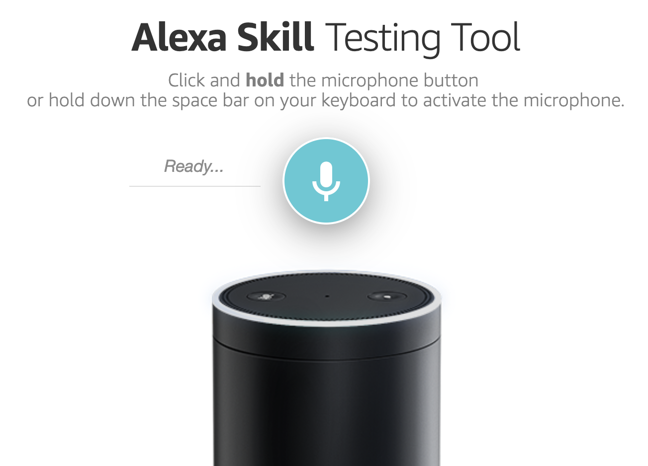
Demo: Cake Walk Skill
Select the microphone button. Then, say the following:
“Alexa, open Cake Walk.”
“Alexa, ask Cake Walk
for my birthday.”
Notes:
Setup:
Make sure you have the Cake Walk skill enabled. You can do this from the Alexa App on your phone.
What to Say:
We’re going to demo a skill that MLH made which asks for your birthday and remembers it!
What to Do:
Demonstrate the Cake Walk Alexa Skill by asking Alexa the following:
“Alexa, open cake walk.”
“Alexa, ask cake walk for my birthday.”
If you have a physical device, use that. Otherwise use the Echo Simulator. (http://echosim.io/)

Slide 26
Awesome! Now that you know what you're going to build, let's return to the Alexa Developer Portal.

Slide 27

Steps to Build Your Skill:
To build your first skill, we’ll complete the following steps:
Create an Alexa Skill in the Developer Portal
Write the Backend Code for Your Skill
Test your Skill
Publish Your Skill
Notes:
What to Say:
These are the 4 steps to create an Alexa skill
In the first two steps, you will setup the main components and connect them together
At the end of this workshop, we’ll be testing out the skills you make
When you go home the next step is to publish your skill!

Slide 28
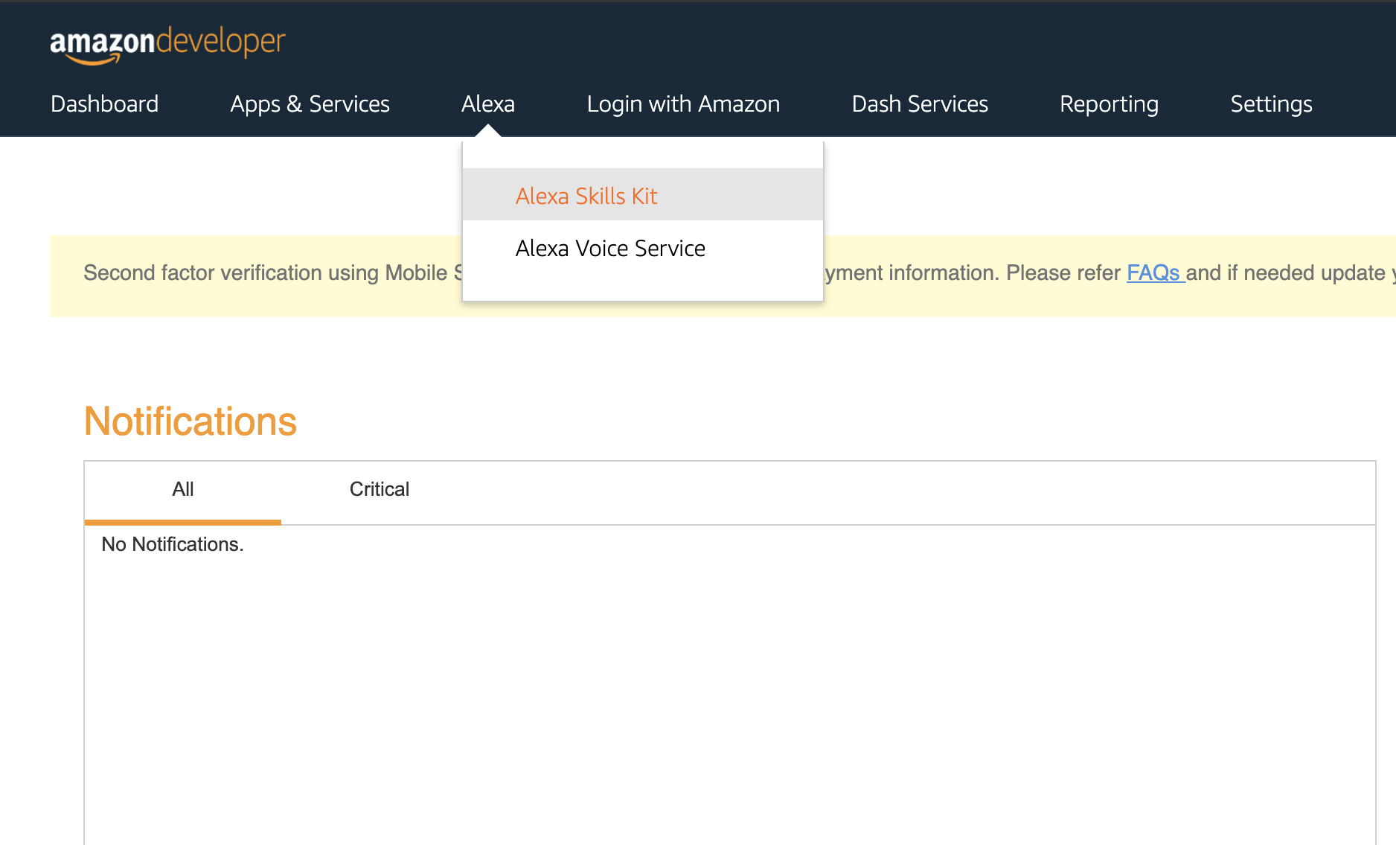
Create a New Alexa Skill
Navigate to Alexa Skills Kit.
Notes:
What to Say:
Now that you’ve signed in, navigate to the “Alexa” link if you aren’t already there.
Find the “Skill Builders” tab and click “Start a Skill” to register you first skill.
This will take you to a list of your Alexa skills. To create a new one, click “Add a New Skill” in the top right.
What to Do:
Make sure everyone is following along and not having any trouble.
NOTE: Amazon released a new version of the skill building interface. If participants are confused or you see that they have a different interface than you see on the slides, click the “Opt Out” link to go back to the original skill building interface.

Slide 29
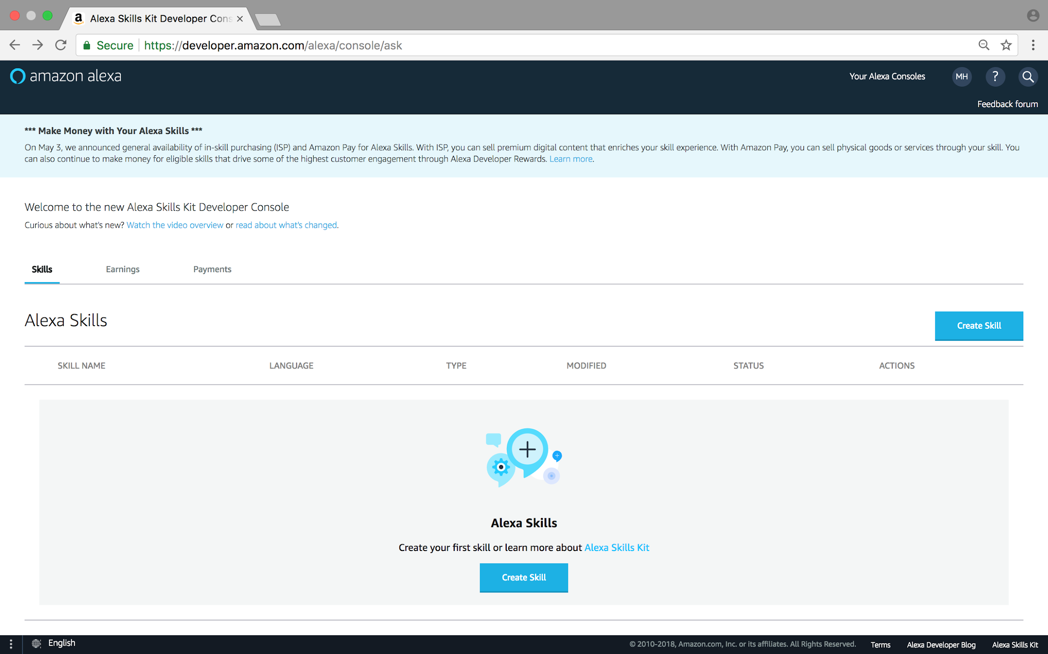
Create a New Alexa Skill
Select Create Skill.
Notes:
What to Say:
To create a new skill, click “Add a New Skill” in the top right (or if it their first skill it will appear in the bottom).
What to Do:
Make sure everyone is following along and not having any trouble.

Slide 30
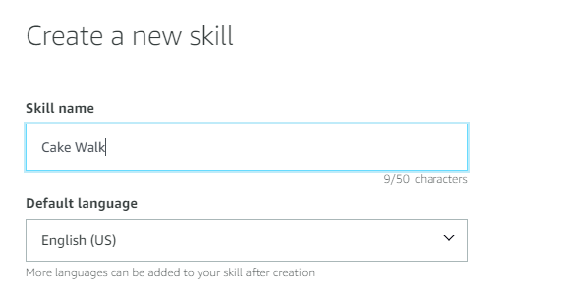
Create a New Alexa Skill
Name your skill Cake Walk (or whatever you wish).
Notes:
What to Say:
They can name the skill whatever they want, just make sure it’s unique to them (i.e. they don’t have another skill with the same name).
What to Do:
Make sure everyone is following along and not having any trouble.
NOTE: Amazon released a new version of the skill building interface. If participants are confused or you see that they have a different interface than you see on the slides, click the “Opt Out” link to go back to the original skill building interface.

Slide 31
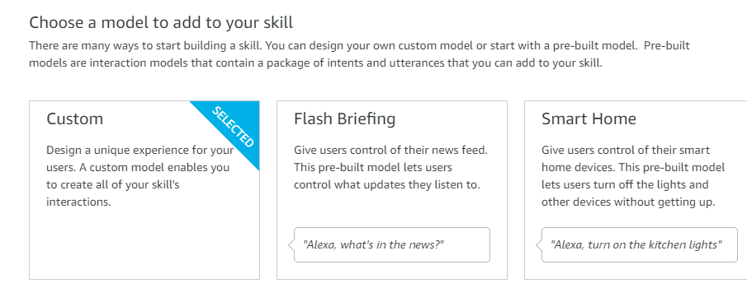
Create a New Alexa Skill
Select Custom for Skill Model Type.
Notes:
What to Say:
Choose the ‘Custom’ Skill Model Type.
What to Do:
Make sure everyone is following along and not having any trouble.

Slide 32
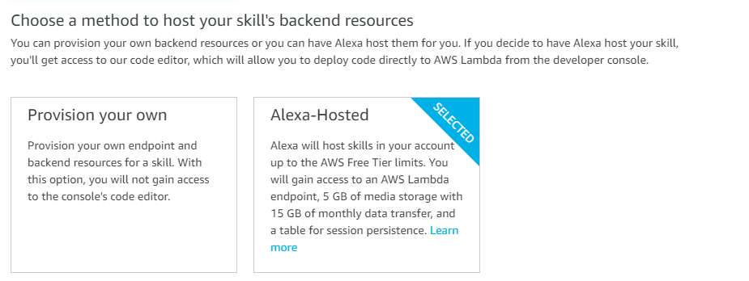
Create a New Alexa Skill
Select Alexa-Hosted for Skill Backend Resource.
Notes:
What to Say:
Now it’s time to configure your skill. Choose “Alexa Hosted” to let Alexa do all the hard work required to host your skill. Remember, this resource is limited, so if your skill gets viral, you will need to move to a self hosted backend.
What to Do:
Make sure everyone is following along and not having any trouble.

Slide 33
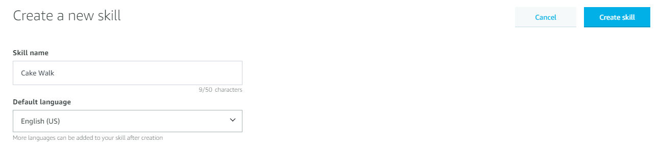
Create a New Alexa Skill
Scroll back to the top. Select Create skill in the top right corner.
Notes:
What to Say:
Click on Create Skill in the top right corner.
What to Do:
Make sure everyone is following along and not having any trouble.

Slide 34
It will take about a minute for your skill to provision. Then, you will be redirected to the Skill Builder.

Slide 35
Table of Contents
1. Introduction to Alexa & Voice UIs
2. Developing For Alexa
3. Develop Your Alexa Skill
4. Customize The Skill
5. Test The Skill
6. Publish Your Skill
7. Review & Quiz
8. Next Steps

Slide 36
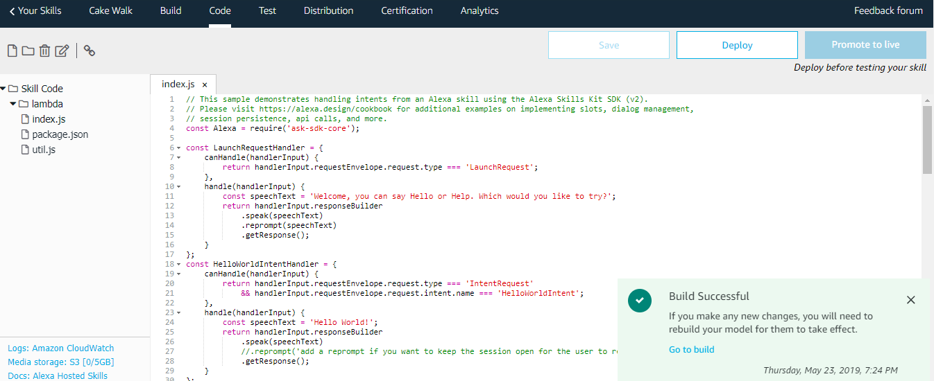
Code The Backend
Select the Code tab at the top of the Skill Builder. Let's understand what the code inside index.js does.
Notes:
What to Say:
Alexa provides a in-site code editor if you choose the Alexa hostel skill option.
The code editor already comes with a lot of code. Don’t worry! We will explain the necessary things as we go along.
If you can’t see the tab, go back, create a new skill with the Alexa hosted option and you will be able to see it.
What to Do:
Make sure everyone is following along and not having any trouble.

Slide 37
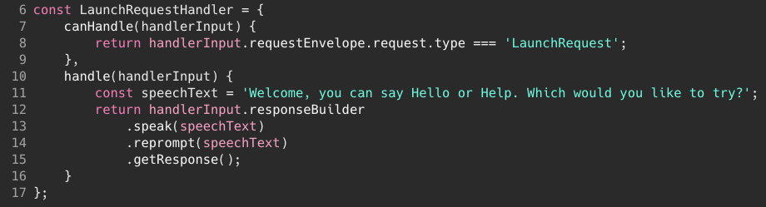
Code Review: The Handlers Object
Alexa skills are composed of handlers.
A handler object tells Alexa how to handle various actions.
LaunchRequestHandler{} contains the code that our Skill will run when someone invokes our skill.
Index.js
Notes:
What to Say:
The canHandle() function is where you define what requests the handler responds to. The handle() function returns a response to the user.
The handle() function uses the responseBuilder function to compose and return the response to the user.
The “LaunchIntent” triggers Alexa to say “Welcome to Cake Walk”.
What to Do:
Walk participants through the code and make sure everyone understands.

Slide 38
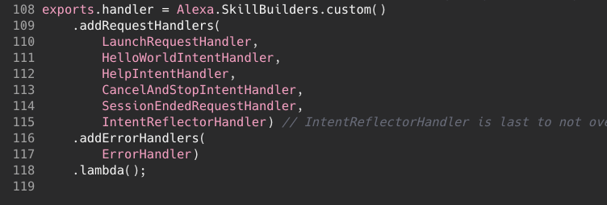
Code Review: The Handler Function
In the last lines of index.js, we export each handler so that they can be used by other parts of the app.
These are the default handlers included with the Cake Walk Skill. You can also write your own!
Index.js
Notes:
What to Say:
The final section passes our configuration to Alexa using the Alexa SDK
We instantiate a new Alexa object and pass it the parsed speech the user gave us
Register the list of handlers we created in the last section so Alexa knows how to respond.
Execute the request.
What to Do:
Walk participants through the code and make sure everyone understands.

Slide 39
Edit your Code
When a user opens an Alexa Skill, Alexa replies with a greeting to let the user know it has opened. Customize what Alexa will say when users invoke your skill on line 11.
Index.js
Notes:
What to Say:
The speechText variable contains the string of words the skill should say back to the user when they launch the skill.
Edit the speechText to whatever you want the skill to say.
What to Do:
Explain how to copy and paste the contents, making sure to highlight the importance of completely overwriting the existing content on the Lambda Editor.
Walk around and make sure participants aren’t having trouble.

Slide 40
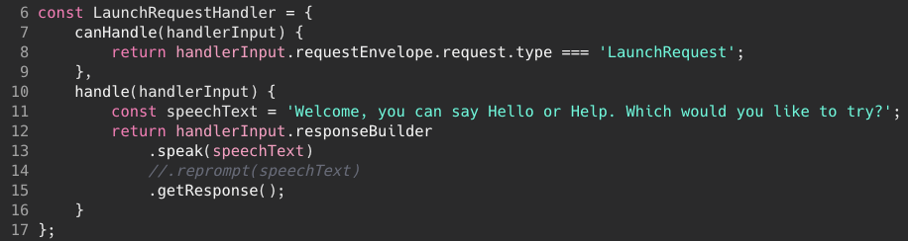
Edit your Code
The Alexa Skills SDK has some built in functions to help us. One of those is .reprompt(), which tells the app to repeat. We don't want to repeat, so add 2 slashes (//) in front of .reprompt() to comment it out.
Index.js
Notes:
What to Say:
Comment out the repromptText line.
This is usually used when you are listening for a user response. Since we are not doing so in this case, we can comment it out.
Make sure to click “Save”.
What to Do:
Explain how to copy and paste the contents, making sure to highlight the importance of completely overwriting the existing content on the Lambda Editor.
Walk around and make sure participants aren’t having trouble.

Slide 41
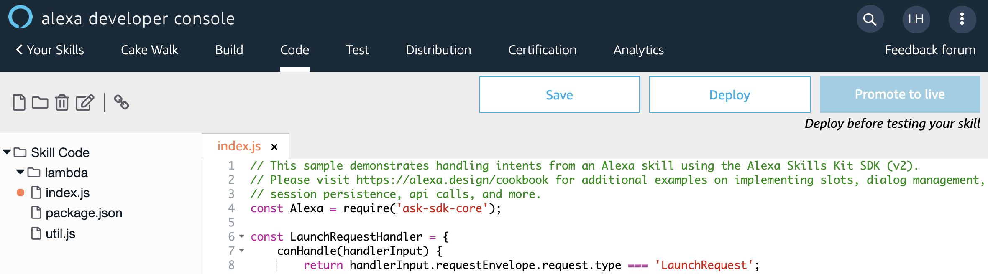
Save And Deploy
Save your Skill.
Then Deploy it so that we can test it!
Notes:
What to Say:
Click “Save” then click “Deploy”
Sometimes the Save button will be greyed out, that means that the code editor has already saved your work.
What to Do:
Walk around and make sure participants aren’t having trouble.

Slide 42
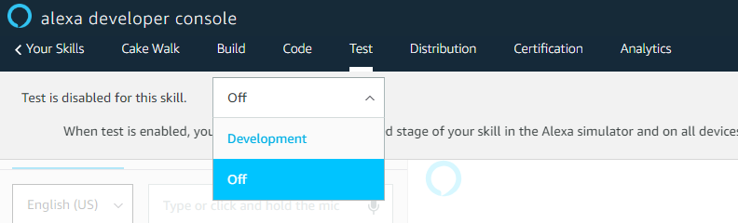
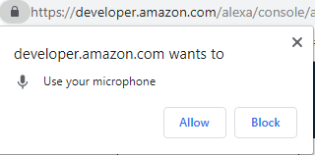
Test Your Skill
Select the Test tab at the top of the page.
Enable testing by clicking Development.
Allow microphone access if prompted.
Notes:
What to Say:
Go to the Test tab on the Alexa console.
Enable tests by clicking on Development, rather than off.
What to Do:
Make sure everyone is ready to start testing their skill.

Slide 43
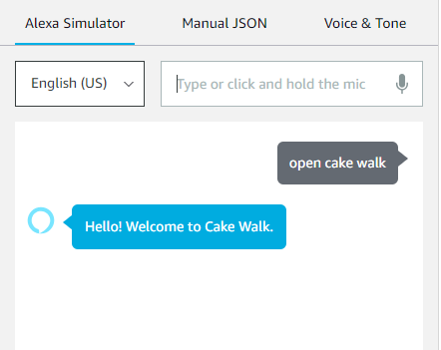
Test Your Skill
You can speak to your Skill or use the type in the text text field. Say "Open Cake Walk."
Notes:
What to Say:
Let’s test the skill!
Type (or speak) the words open cake walk.
This is not case sensitive, so you need not worry about upper-casing anything.
Alexa should reply (both display and speak) whatever sentence you put in the variable speechText.
What to Do:
Ensure everyone is able to get a response from Alexa.
If not, check if they are using the right invocation name and that no other skill with the same name exists in their skill library.

Slide 44
Great! Now you have created and tested a simple skill.
Let’s improve this now.

Slide 45

Steps to Build Your Skill
Now that your skill is working, we're going to add the following functionality:
Ask the User a question.
Listen for the answer.
Respond.
Notes:
What to Say:
These are the 4 steps to create an Alexa skill
In the first two steps, you will setup the main components and connect them together
At the end of this workshop, we’ll be testing out the skills you make
When you go home the next step is to publish your skill!

Slide 46
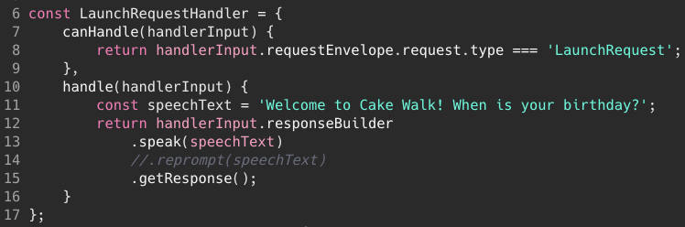
Customizing Your Skill
We will now ask the user for their birthday when the app launches.
Return to the Code tab.
In index.js, edit the speechText variable to ask for the user’s birthday.
Notes:
What to Say:
Let’s customize this skill now.
We can modify the skill to ask for the user’s birthday on app launch.
To do this, go back to index.js and edit the speechText variable to ask for the user’s birthday.
What to Do:
Walk around and make sure participants aren’t having trouble.

Slide 47
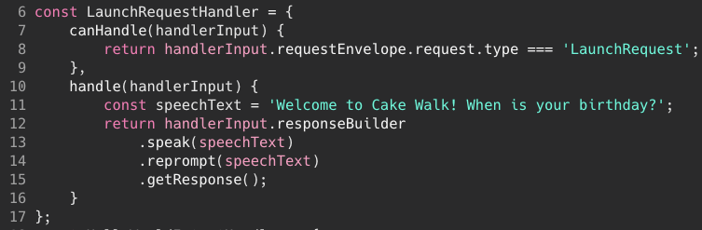
Customizing Your Skill
Now we want to allow the Skill to re-prompt the user. Remove the slashes you added before.
Notes:
What to Say:
Click “Save.”
What to Do:
Walk around and make sure participants aren’t having trouble.

Slide 48
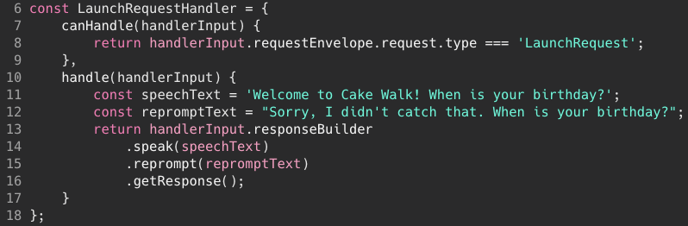
Customizing Your Skill
The best practice is to keep the speech and reprompt text different, so now we're going to add a variable for the reprompt text. Add Line 12 to your code.
Then, change the variable name on Line 15 to repromptText.
Notes:
What to Say:
Click “Save.”
What to Do:
Walk around and make sure participants aren’t having trouble.

Slide 49
Save And Deploy
Save your Skill.
Then Deploy it so that we can test it!
Notes:
What to Say:
Click “Save” then click “Deploy”
Sometimes the Save button will be greyed out, that means that the code editor has already saved your work.
What to Do:
Walk around and make sure participants aren’t having trouble.

Slide 50
Great! You told Alexa to ask for input. But how are you going to save it and respond to it?

Slide 51
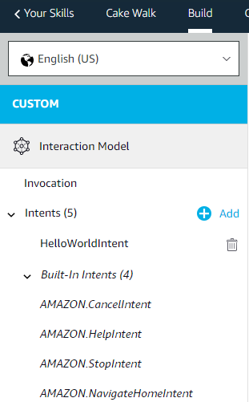
Create An Intent
We need to create an intent!
Return to the Build tab.
You should be able to see a list of Intents on the left hand side.
Click on the Add button to create a new intent.
Key Term
Intent: an action to fulfill a user’s request
Notes:
What to Say:
Let us add a new intent.
In the left hand side of the build page, you should see a HelloWorldIntent and a few built in intents. On the top right, you will see an Add button. Click on that to add a new intent.
What to Do:
Walk around and make sure participants aren’t having trouble.

Slide 52
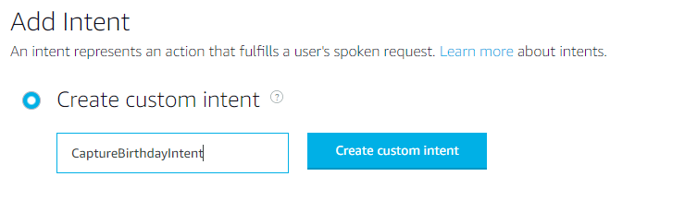
Create An Intent
Name the intent CaptureBirthdayIntent, and click on Create custom intent.
Notes:
What to Say:
Name the intent CaptureBirthdayIntent, because we will be using this to get information about the user’s birthday.
Notice the words are not separated by spaces, and each new word begins with an uppercase letter.
Click on Create custom intent.
What to Do:
Make sure everyone is following along and not having any trouble.

Slide 53
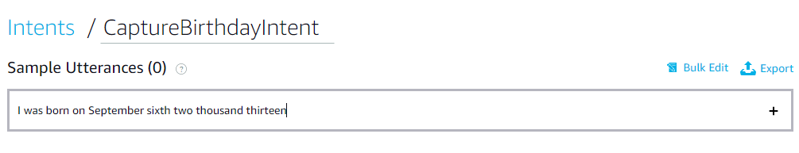
Customize your Utterances
In the Sample Utterances field, type I was born on September Sixth Two Thousand Fourteen.
Add a few other ways someone might tell Alexa their birthday, such as, "My birthday is October Thirteenth Nineteen Eighty-Nine" or simply, "March Fourth."
Notes:
What to Say:
Remember, an intent is an action to fulfill a user's request. An utterance is what invokes the intent.
The next thing we need to configure is the set of Sample Utterances.
Type the following utterance and click on the + button.
Notice that the text does not include punctuation.
This is not meant to be an exhaustive list, but should be a set of basic examples of how you want users to interact with your skill.
What to Do:
Ask if anyone has an example for a sample utterance.
Make sure everyone is following along and not having any trouble.

Slide 54
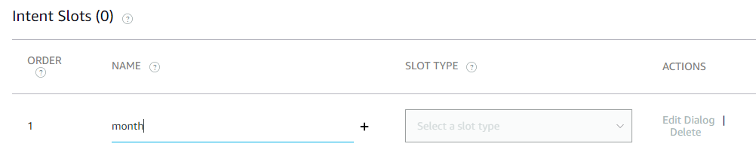
Add Slots
We need Alexa to collect 3 pieces of information - the date, the month and the year of the user’s birthday. These are called slots.
Key Term
Slot: a piece of information Alexa can capture.
Scroll down to the Intent slots section.
Name the slot month and click the + button.
Notes:
What to Say:
You need to create a slot for every piece of information you want Alexa to collect. In this case it is month, date and year.
What to Do:
Make sure everyone is following along and not having any trouble.

Slide 55
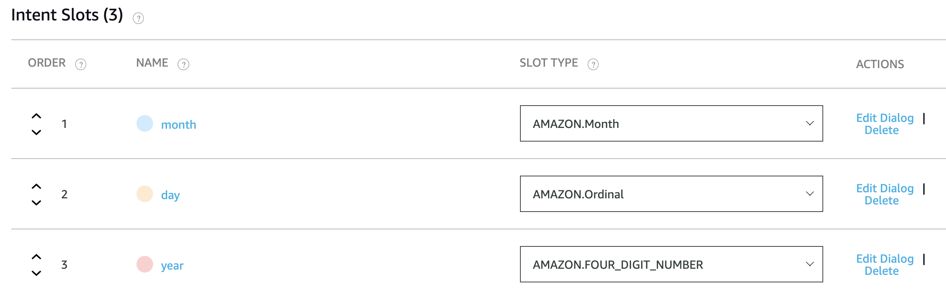
Add Slots
Add slots for day and year as well.
SLOT TYPE for Month is amazon.month
Date is amazon.ordinal. Year is amazon.fourdigit
Save.
Notes:
What to Say:
Add slots of day and year similarly.
We need to define a slot type for each slot so that Alexa knows what value it is looking for.
There are two types of slot types: custom and built-in. Wherever possible, use built-in slots. Alexa manages the definitions of built-in slots.
For the month slot, there is a inbuilt type called Amazon.MONTH
What to Do:
Ask everyone what they think the slot type for date and year should be.
Make sure everyone is following along and not having any trouble.

Slide 56
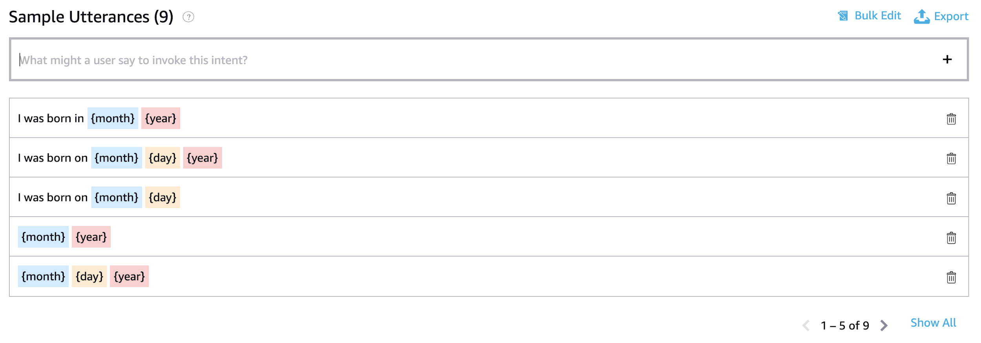
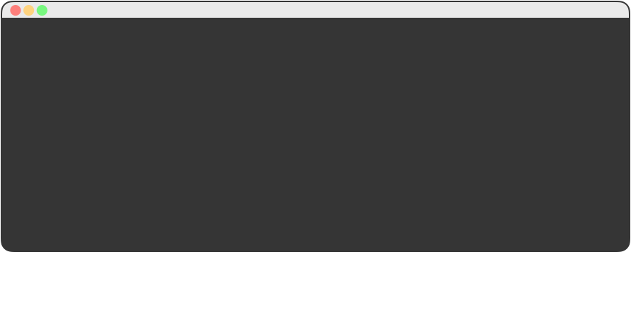
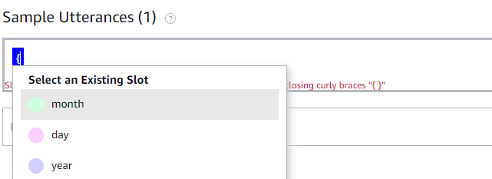
Add More Sample Utterances
In the sample utterances, we can replace exact words with the slot variables. For example,
I was born on September sixth two thousand thirteen
can be written as
I was born on {month} sixth two thousand thirteen
Add the following sample utterances to the list as well:
{month} {day}
{month} {day} {year}
{month} {year}
I was born on {month} {day}
I was born on {month} {day} {year}
I was born in {month} {year}
Notes:
What to Say:
In the sample utterances, we can replace exact words with the slot variables.
Slot variable names have to be surrounded by curly braces {}
When you type in the {, the console will immediately show you a list of existing slots.
Type in all the sample utterances one by one and don’t forget to click the + button to add the utterance.
Save the model.
What to Do:
Ask everyone to think of at least one other sample utterance if possible.
Make sure everyone is following along and not having any trouble.

Slide 57
Now Alexa has a way to ask for input and somewhere to save it. But what if it goes wrong?

Slide 58
Add Dialog Management
What if the user does not give out all the information in one go? What if he gives only the month or date?
Dialog management can help us get the information to fill the missing slots.
If you need a given value from the user, you can designate a slot as required and Alexa will ensure that the value of the slot is collected.
Notes:
What to Say:
Slots can be required or optional.
If you need a given value from the user, you can designate a slot as required using dialog management. Marking a slot as required triggers Alexa to actively work to fill it.
What to Do:
Make sure everyone is following along and not having any trouble.

Slide 59
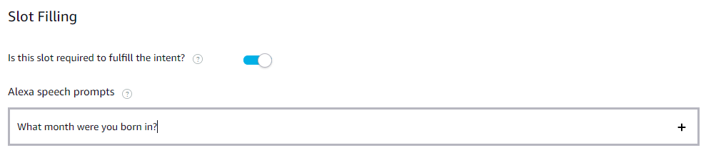
Add Dialog Management
Go back to the Intent slots section. Click on the Edit Dialog option next to the month slot.
Turn on Is this slot required to fulfill the intent?
Notes:
What to Say:
Make the month slot as required by clicking on the Edit dialog to the right of the slot type.
Turn on “Is this slot required to fulfill the intent?”
What to Do:
Make sure everyone has made the slot required and has set a question to as a prompt.
Make sure everyone is following along and not having any trouble.

Slide 60
Add Dialog Management
Add a question Alexa can use to prompt the user if they don't say the month.
Click the + sign to add the prompt.
Notes:
What to Say:
Make the month slot as required by clicking on the Edit dialog to the right of the slot type.
Turn on “Is this slot required to fulfill the intent?”
What to Do:
Make sure everyone has made the slot required and has set a question to as a prompt.
Make sure everyone is following along and not having any trouble.

Slide 61
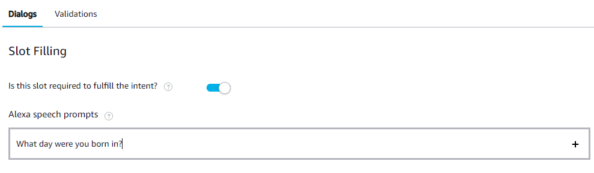
Add Dialog Management
Repeat for day and year.
Notes:
What to Say:
Make the month slot as required by clicking on the Edit dialog to the right of the slot type.
Turn on “Is this slot required to fulfill the intent?”
What to Do:
Make sure everyone has made the slot required and has set a question to as a prompt.
Make sure everyone is following along and not having any trouble.

Slide 62
Now Alexa can use the user for their birth month, day, and year if any of them is missing.

Slide 63
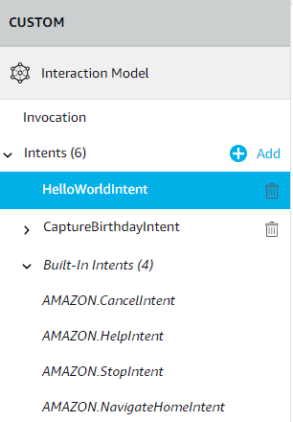
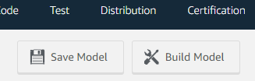
Build the Model
You will see a HelloWorldIntent above the CaptureBirthdayIntent. Delete the HelloWorldIntent.
Do NOT delete the built-in intents.
Save and build the model.
Notes:
What to Say:
You can delete the unnecessary HelloWorldIntent by clicking on the trash icon next to the Intent name.
Save and build the model.
What to Do:
Make sure everyone is following along and not having any trouble.
Make sure no one deleted any built in intents by mistake.

Slide 64
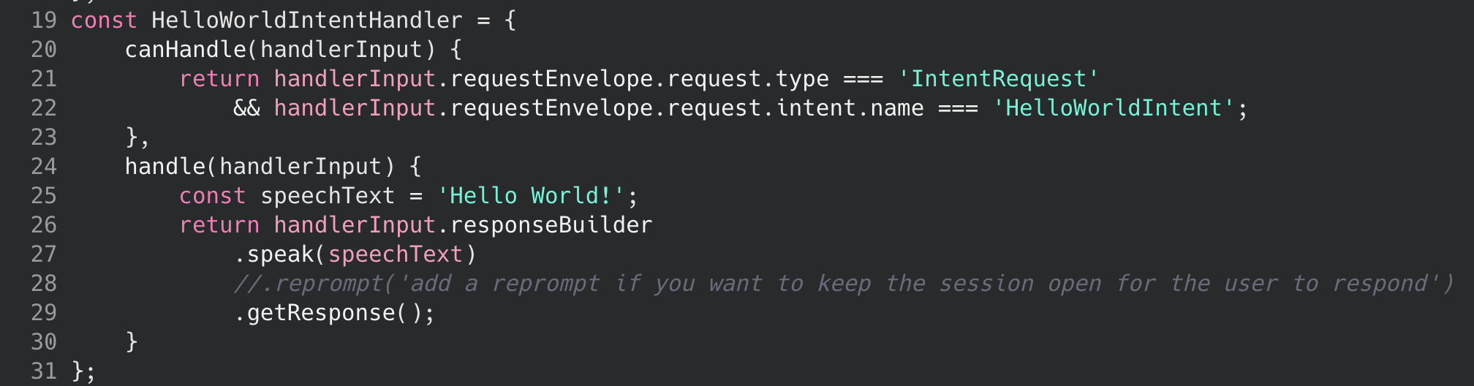
Update the Backend
Go back to the code editor.
If you look at the code, you will see a HelloWorldIntentHandler, but we deleted the HelloWorldIntent. We will modify the HelloWorldIntentHandler code we require.
Notes:
What to Say:
Go back to the Code editor by clicking on the Code tab of the Alexa Console.
The code has HelloWorldIntentHandler, but we deleted the HelloWorldIntent. So let’s modify that handler to handle the CaptureBirthdayIntent.
What to Do:
Make sure everyone is following along and not having any trouble.

Slide 65
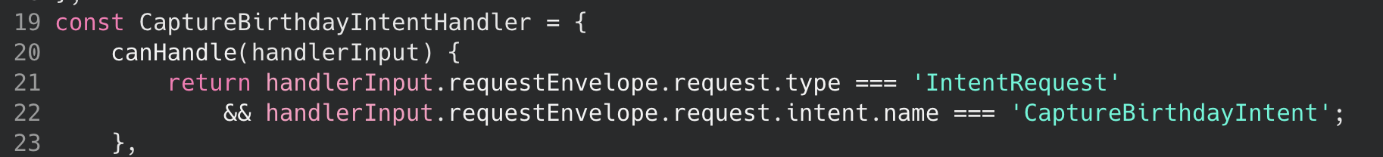
Update the Backend
In line 19, replace HelloWorldIntentHandler with CaptureBirthdayIntentHandler.
In line 22, replace the HelloWorldIntent with CaptureBirthdayIntent.
Notes:
What to Say:
Modify the name of the handler to CaptureBirthdayIntentHandler
In the canHandle method of the handler, ensure that the request intent name is ‘CaptureBirthayIntent’ instead of ‘HelloWorldIntent’
What to Do:
Make sure everyone is following along and not having any trouble.

Slide 66
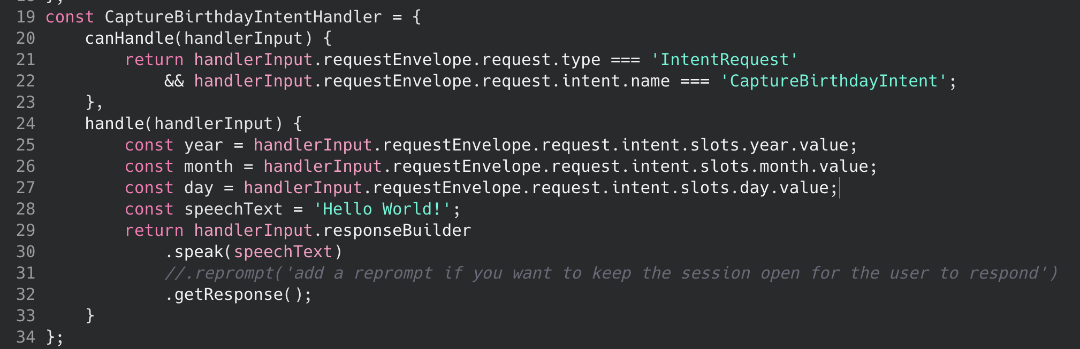
Update the Backend
Add lines 25, 26, and 27 to your code. Note that if the names of your slots are not exactly month, day, and year, this code won't work properly.
Notes:
What to Say:
Create 3 variables in the handler to save the slots the skill is collecting.
handlerInput.requestEnvelope.request.intent.slots. Gets the list of slots, after that we put the name of the slot and finally to get the value of the slot we put a .value
What to Do:
Make sure everyone is following along and not having any trouble.

Slide 67
Update the Backend
Update the value of speechText on or around Line 28 to match what you see below. Note that we have changed the single quotation marks ('') to be backticks (``) instead.
Notes:
What to Say:
Replace the value of the speechText variable to let Alexa speak out the user’s birthday.
String interpolation allows you to drop the new variables into a text string.
Notice that you need to surround the variable name with ${} and you also need to use the special quote symbol (usually present to the left of 1 in the keyboard).
What to Do:
Make sure everyone is following along and not having any trouble.

Slide 68
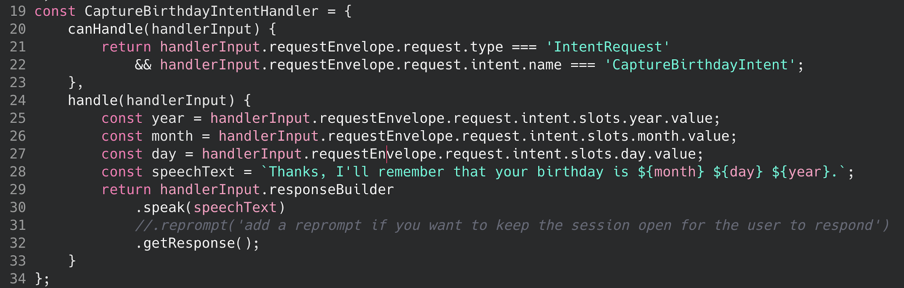
Update the Backend
The final handle() method should look like this.
Notes:
What to Say:
The handle method should look something like this.
What to Do:
Ensure all the participants have the exact same code in their index.js
Make sure everyone is following along and not having any trouble.

Slide 69
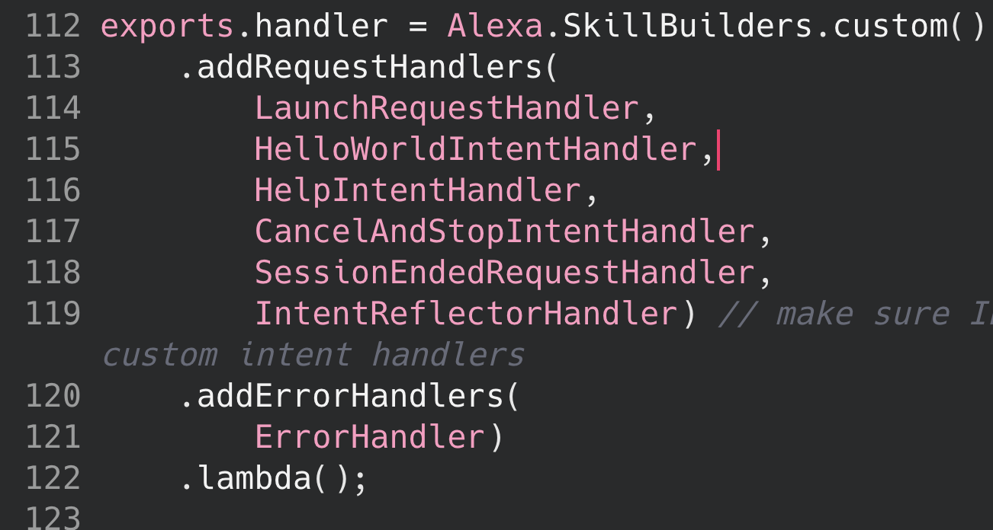
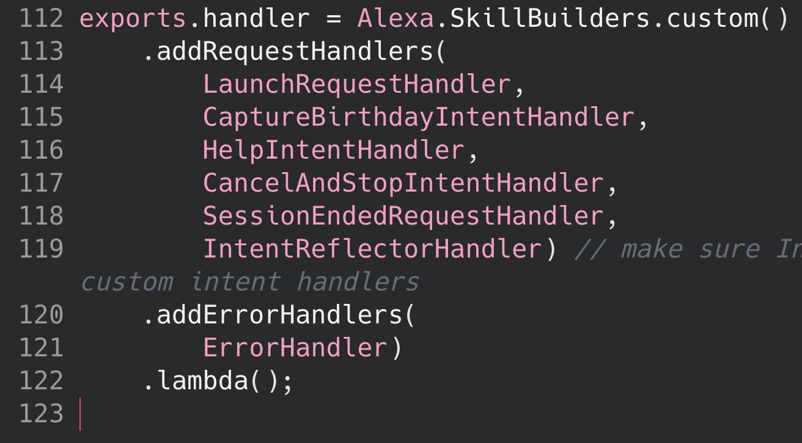
Update the Backend
Finally, scroll to the bottom of your code and update the handler exports with the new handler you created by replacing HelloWorldIntentHandler with our new CaptureBirthdayIntentHandler.
Notes:
What to Say:
Almost done! Remember the exports.handlers sections where we notify the SDK of all available handlers? We need to register our new handler there.
Go to line 45 in index.js and replace HelloWorldIntentHandler with our new CaptureBirthdayIntentHandler.
What to Do:
Make sure everyone is following along and not having any trouble.

Slide 70

Save and Deploy
Once again, save and deploy the code.
Notes:
What to Say:
Click “Save” then click “Deploy”
Sometimes the Save button will be greyed out, that means that the code editor has already saved your work.
What to Do:
Walk around and make sure participants aren’t having trouble.

Slide 71

Test Your Skill
Go back to the test tab to test your skill.
Notes:
What to Say:
All done! Now test your skill.
Go to the test tab and speak/ type ‘open cake walk’ to invoke your skill.
When Alexa asks for your birthday, provide it any of the formats we gave in the sample utterances.
If you are typing, ensure you spell it out (two thousand fourteen instead of 2014). You can speak normally and Alexa will understand.
Alexa should reply that she will remember your birthday.
What to Do:
What to Say:
What to Do:
Ensure everyone is able to get the skill working.

Slide 72

Test Your Skill
What happens if you do not specify the month or date or year?
Notes:
What to Say:
What happens if you do not specify the month or date or year?
Alexa should prompt you with the question you specified in the dialog management section.
What to Do:
Ensure everyone is able to get the skill working.

Slide 73
Troubleshooting Your Skill
If you aren't getting a valid response, check the following:
Are you calling the right invocation name?
Are you saying launch, start or open?
Are you sure you have no other skills in your accounts with the same invocation name?
Did you Save and Deploy your changes?
Notes:
What to Say:
If you’re having trouble, here are some common issues that people encounter when making their first Alexa skill.
What to Do:
Walk around and make sure that everyone is able to successfully test their skill.

Slide 74

Let’s recap quickly...
1
Voice User Interfaces allow us to physically separate ourselves from devices.
2
Amazon Alexa makes it easy for you to create apps (skills) that utilize Voice User Interfaces.
3
Alexa takes care of speech recognition and context so you can focus on making a great app.
Notes:
What to Say:
Here’s a quick summary of the main points we covered
Voice User Interfaces are a new type of interface that allow us to physically separate ourselves from devices.
Amazon Alexa makes it easy for you to create apps (called skills) that utilize Voice User Interfaces to do things.
Amazon Alexa takes care of hard stuff like speech recognition and context so you can focus on making a great app.
What to Do:
Summarize the workshop learnings and recap what participants accomplished over the last hour or so.

Slide 75
Table of Contents
1. Introduction to Alexa & Voice UIs
2. Developing For Alexa
3. Develop Your Alexa Skill
4. Customize The Skill
5. Test The Skill
6. Publish Your Skill
7. Review & Quiz
8. Next Steps

Slide 76
What did you learn today?
We created a fun quiz to test your knowledge and see what you learned from this workshop.
http://mlhlocal.host/quiz
Notes:
What to Say:
Ok. It’s time to see what you learned today. Open up the following URL in your browser to complete the quiz and a short survey about this workshop
Once you finish, raise your hand and let me know what your score was!
What to Do:
Walk around and make sure participants are able to take the quiz.
Make sure everyone completes the quiz and survey. We use this information to improve the workshop for future hackers!

Slide 77
Table of Contents
1. Introduction to Alexa & Voice UIs
2. Developing For Alexa
3. Develop Your Alexa Skill
4. Customize The Skill
5. Test The Skill
6. Publish Your Skill
7. Review & Quiz
8. Next Steps

Slide 78

Next Steps: Store the user’s birthday
Alexa also provides you with S3 storage that lets you persist data. See how you can leverage that to remember the user’s birthday so that you do not ask them everytime.
Read up about S3 storage and how to use them in the Alexa Code Editor.
Retrieve the user’s birthday, if it exists, on launch, so that you can decide whether to ask the question or not.
Notes:
What to Say:
If you’re looking for something a little more challenging, why not try using Amazon S3 to remember the user’s birthday?
What to Do:
Give the overview of this challenge and move on to the next slide. The full details will be in participants emails.

Slide 79

Learning shouldn't stop when the workshop ends...
Check your email for access to:
These workshop slides
Practice problems to keep learning
Deeper dives into key topics
Instructions to join the community
More opportunities from MLH!
Notes:
What to Say:
What to Do:

Slide 80
v.0.0.1

